Slide 1

DevOps & Cloud Infrastructure SEIS 665 Week 1 Distributed Infrastructure Patterns
Jason Baker
Adjunct Instructor
Graduate Programs in Software
University of St. Thomas
St. Paul, MN

Slide 2
Agenda
Introduction to the course
Review syllabus
Distributed Infrastructure Patterns

Slide 3
About Your Instructor
2015 Graduate of UST GPS program with M.S. in Software Engineering
25 years in IT working with tech startups, midsize, and Fortune 500
Co-founded the largest datacenter company in Minnesota.
Currently DevOps Engineer with Spok
AWS Certified Solutions Architect & Developer
Hobbies include underwater photography, cycling, analog synths, and woodworking.

Slide 4
Introduce yourself
Your name
Major
AWS experience

Slide 5
Manufacturers in the 1980's faced a challenge:
Protect sales (↑ inventory)
OR
Reduce costs (↓ inventory)

Slide 6
Solution: Lean Production System (Toyota)

Slide 7
Companies building software face challenges:
Produce value quickly
Deliver reliable services

Slide 9
2.7 million

Slide 10
DevOps defined
DevOps is a culture that embraces collaboration and automation to improve the quality and velocity of the service delivery lifecycle.

Slide 11
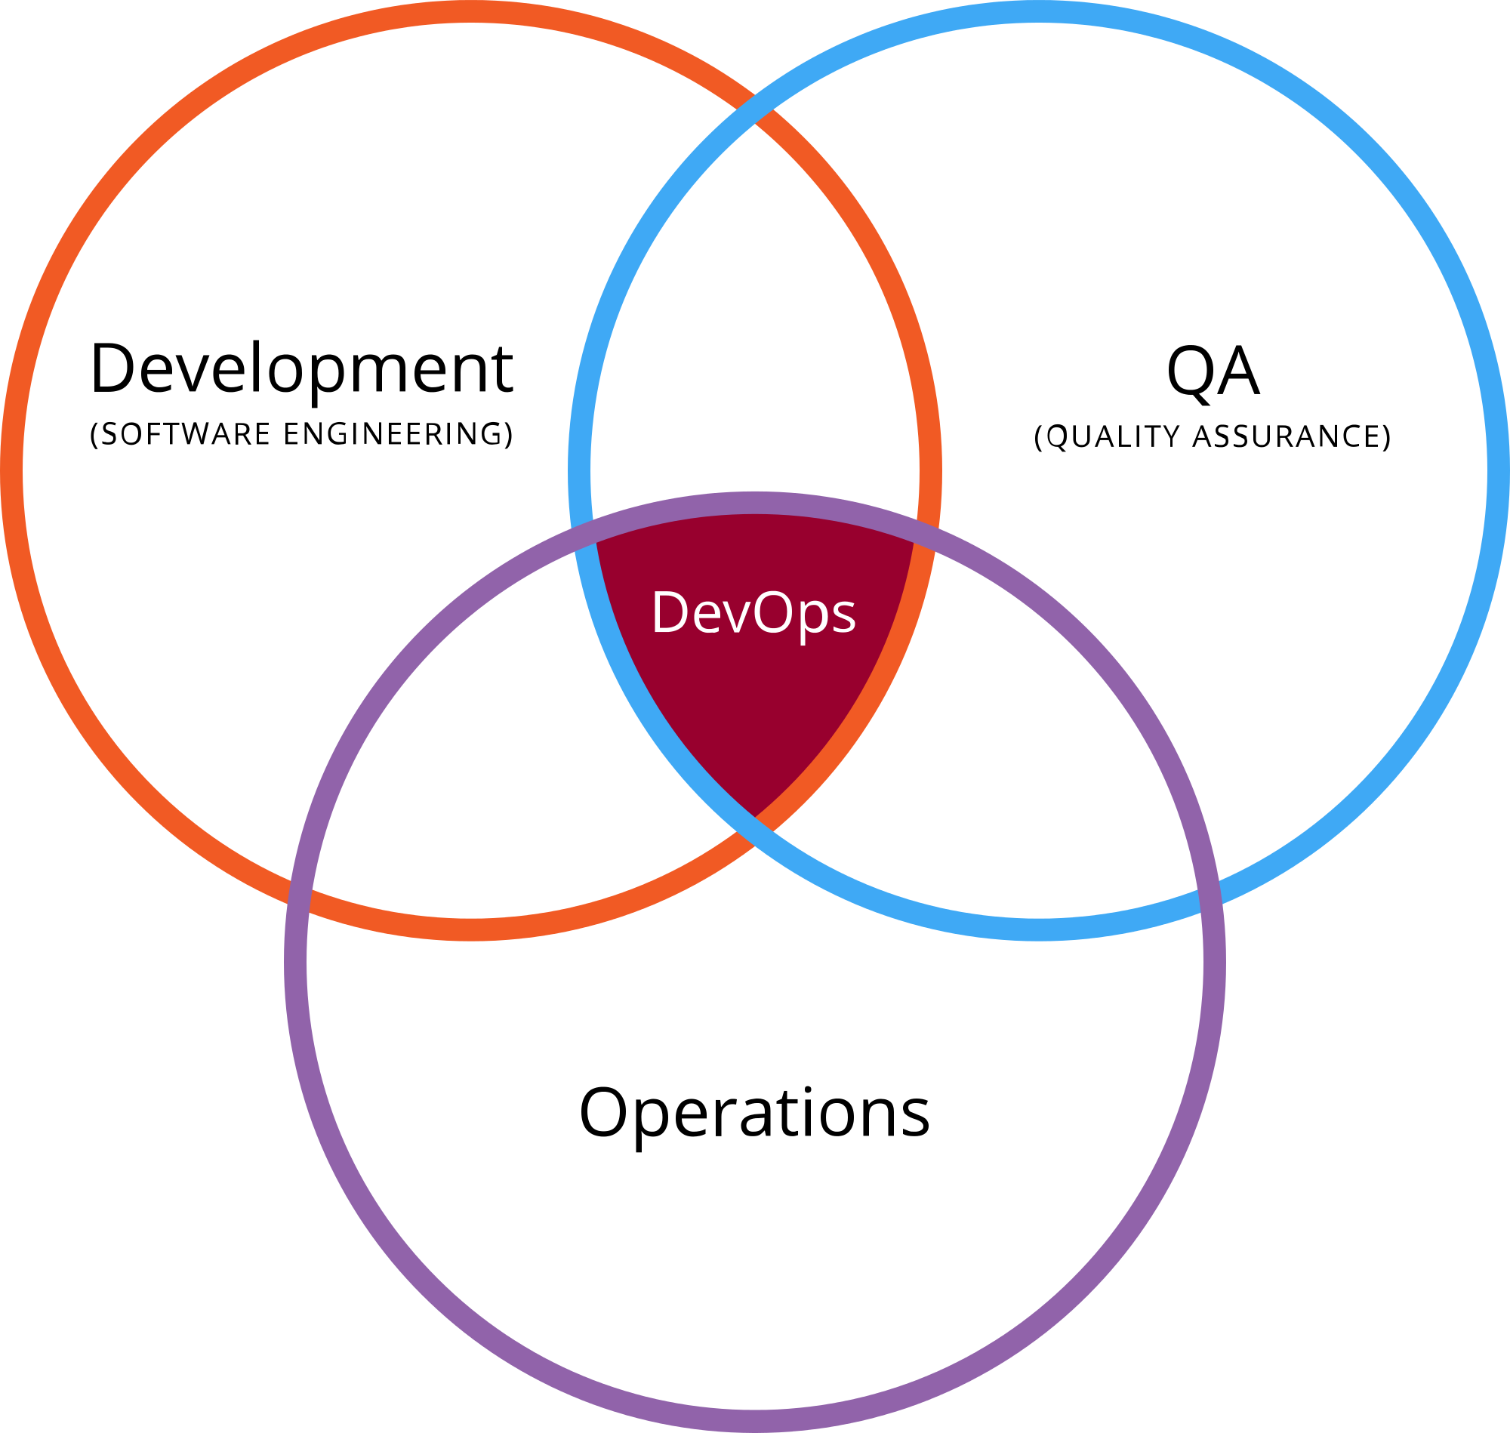
What is DevOps?
A methodology combining multiple practices within the IT organization.

Slide 12
Why does DevOps matter?
2018 State of DevOps Report:
Survey of over 25,000 technology professionals over 5 years.
An attempt to quantitatively understand how technical and cultural practices associated with DevOps affect IT performance.
Categorized IT organizations as Elite, High, Medium or Low performers.

Slide 13
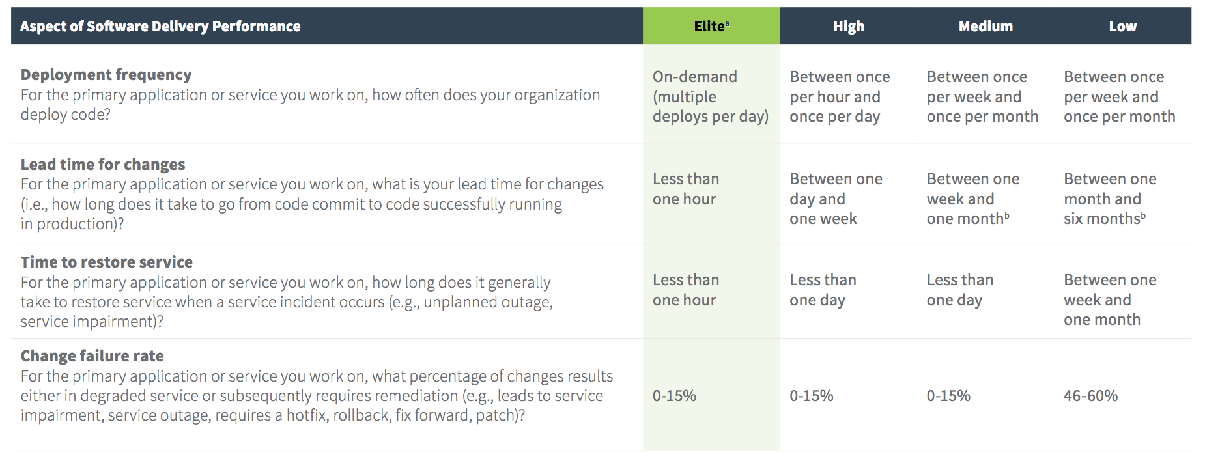
Source: 2018 State of DevOps Report

Slide 14
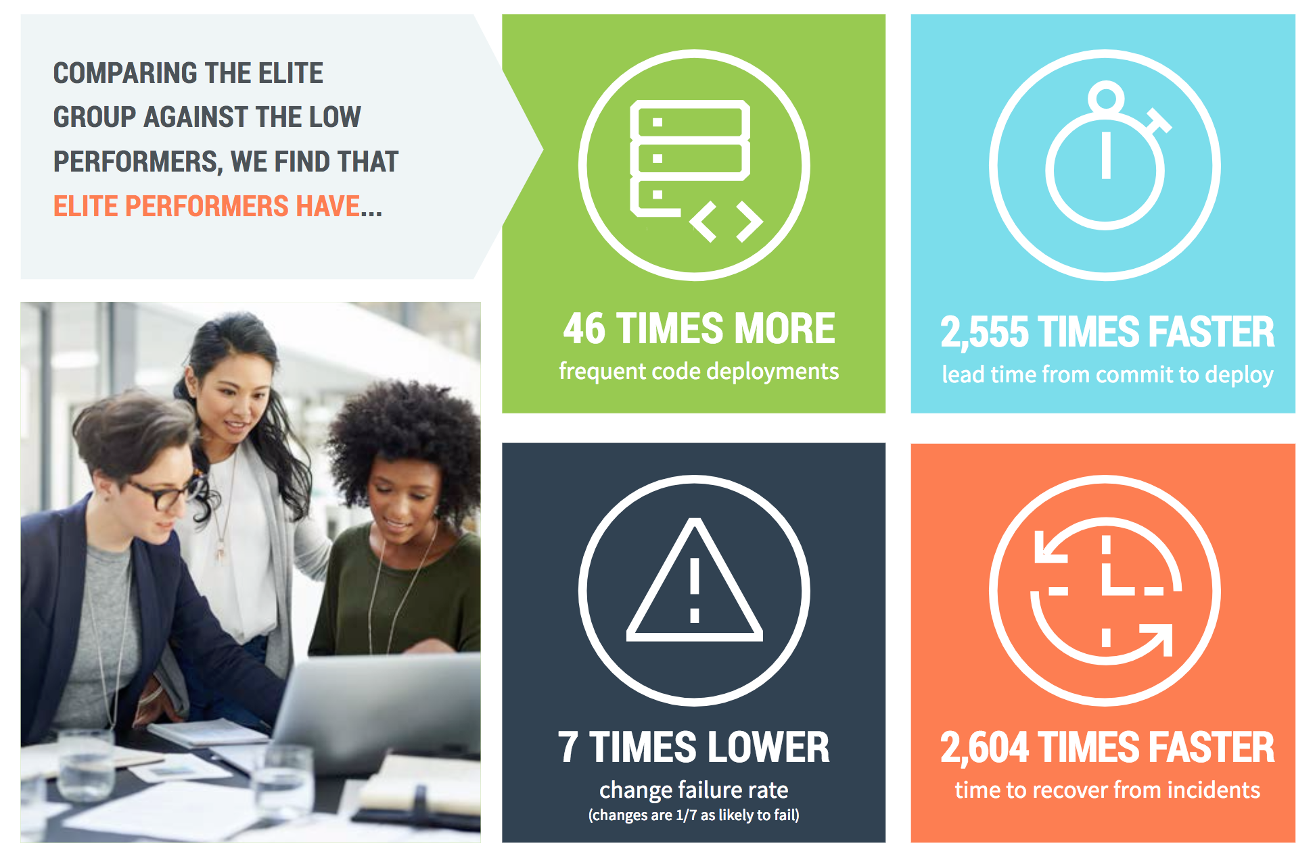
Source: 2018 State of DevOps Report

Slide 15
Source: 2016 State of DevOps Report

Slide 16
Infrastructure
What do we mean by “infrastructure”?
IT infrastructure provides all the necessary compute, storage, networking and software components necessary to deliver a service.

Slide 17

Traditional IT

Slide 18
Traditional IT
Hand-built infrastructure based on physical hardware and guided by experience.
Every infrastructure component is unique and special.
Built at different times with slightly different processes.
Built by different people with different levels of experience.
“Just make it work.”
Infrastructure is rarely replaced and is fanatically supported throughout its lifecycle.
Infrastructure changes are carefully controlled by a Change Advisory Board (CAB).

Slide 19
Traditional IT
Role of IT operations staff:
Gatekeepers for all IT services in the organization.
“The Office of No.”
Often partitioned into specialist teams:
Network engineers
Storage engineers
Security analysts
DBAs
Ops team focused on preventing infrastructure failure.
“Keep the lights on.”

Slide 20

Traditional IT server builds
The server build process:
Purchase request
Purchase order
Receive components
Build server
Test build/ update firmware
Install OS/Hypervisor
Test server
Rack server
Network provisioning
Storage provisioning
Firewall provisioning
Application server installation
Backup/ Monitoring provisioning
Disaster recovery provisioning
Security testing
Data migration
Application service testing
1 to 6 months later you have a server!

Slide 21
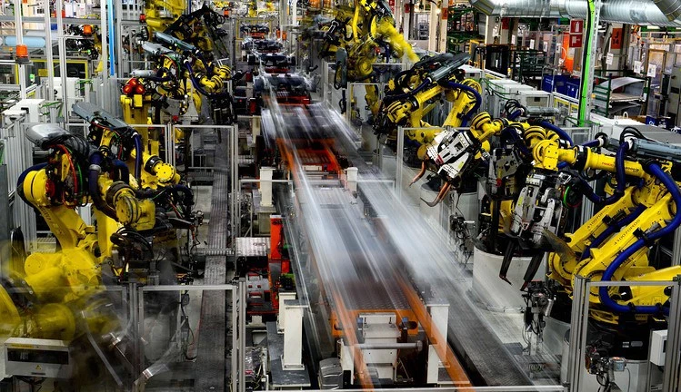
Modern IT

Slide 22
Modern IT
Design automated infrastructure that is repeatable and testable.
Humans build the machines that build the infrastructure.
Elimination of snowflakes – unique infrastructure components.
Infrastructure is constantly being replaced.
”We embrace change.”
Infrastructure changes are automated by a change management pipeline instead of a review board.

Slide 23

Modern cloud servers
The cloud server build process:
Review current computing budget quotas
Select pre-validated infrastructure stack
Deploy stack into virtual data center
Automatically load application services and data
2 minutes later you have a server!

Slide 24
Cloud Infrastructure
Scripted,
automated
infrastructure
available on
demand from a
global cloud
computing service.
Forbes: 83% of enterprise workloads will be in the cloud by 2020
We’ve already passed the tipping point!

Slide 25

Topics this semester
Automation
Shell scripting
Virtualization
Cloud computing
Infrastructure Definition
Configuration Management
Serverless Applications
Containers
Software build pipelines
Service orchestration

Slide 26
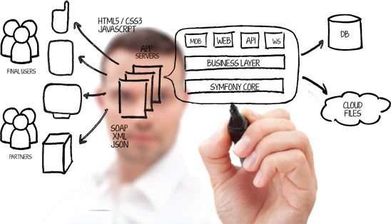
Course Syllabus

Slide 27
Syllabus Notes
This course is a journey, not a destination. It takes years to become an expert.
We will write code and work with new technologies every week.
Nobody is a true expert in all of these topics, including me.
Assignments will start out fairly easy at first, but become more challenging over time.

Slide 28
Assignments
Quotes from students last few years:
Student 1: “The home work assignments were way too easy to complete.”
Student 2: “These were the most difficult assignments in my entire grad school experience. I spent 10 or more hours on each assignment.”
Student 3: “I was able to take lessons from your class and apply them at work the next day!”

Slide 29
Assignment Submission
All assignments are submitted via GitHub in this course. No paper or e-mail submissions are accepted.
You are expected to research and quickly learn Git and the GitHub platform on your own.

Slide 30
Assignment Grading
Assignment grading is performed in a mostly automated fashion using a software test suite.
Assignments must pass a series of tests to receive full points.
#1 cause of losing points: missing files, incorrect file naming, incorrect file locations.
Case in file names matters!
Double-check your work.
Assignments must meet the requirements AND follow good engineering practices: clarity and maintainability.

Slide 31
Attendance

Slide 32
What is distributed infrastructure?
A computing architecture where software components are running on multiple computing systems.
Web servers
Database servers
Message bus servers
Load balancers
We need this to scale our software platform to support thousands or millions of users.

Slide 33
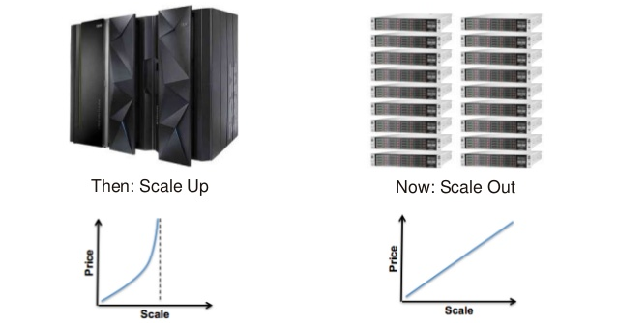
How do we scale our platform to support more users?

Slide 34
Scale Up vs. Out
Example: Single large server vs. many small servers.
Single large server | Multiple small servers
Easy to maintain | More challenging to maintain, need to sync content and handle performance differences
Finite amount of processing, memory & I/O | Unlimited* amount of processing, memory & I/O
Requires no special application support. | Application needs to support distributed deployment architecture (stateless, ephemeral, etc.)
* Nothing is really unlimited ☺

Slide 35
Distributed infrastructure challenges
May need to support thousands of users concurrently.
Need to route user requests through the appropriate services on different computing nodes.
Need to distribute and partition data across many systems.
Need to provide fault tolerance to deliver a reliable service.

Slide 37
Distributed infrastructure patterns
A bit about patterns…
A pattern is a common architectural model which generally meets specified requirements or solves a problem.
An anti-pattern is an architectural model which generally leads to an unsatisfactory outcome.
Many anti-patterns started out as patterns, but then became anti-patterns as technologies evolved.

Slide 38
Distributed infrastructure patterns
4 useful distributed infrastructure patterns:
Load balancing
Caching
Message queues
Database sharding

Slide 39
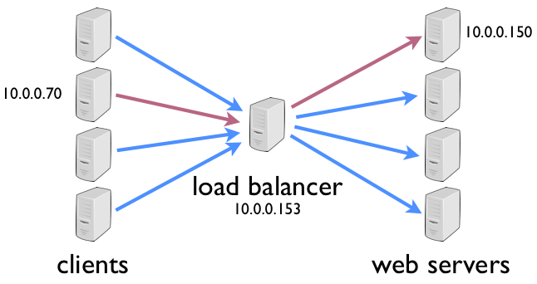
Load balancing
A load balancer is a service which takes an incoming request and routes it to one of many backend servers.
Example: Internet request is routed to one webserver in a fleet of servers.
LB watches the health of servers and dynamically re-routes requests if a server fails.

Slide 40
Load balancer distribution
A load balancer can use a variety of algorithms to determine which server should handle a request.
Random: each incoming request is sent to a random server in the fleet
Round-robin: each incoming request is sent to a different
Others: Weighted round-robin, Least Load…

Slide 41
Caching
An in-memory caching service accelerates access to data and improves service response.
Database I/O is oftentimes the greatest performance constraint in a distributed application.

Slide 42
Message queue
A message queue decouples services and allows producers (senders) to send messages to consumers (receivers).
Prevents one service from overwhelming another service with requests.
Allows for asynchronous, batch handling of requests.
Increases application reliability (retries)
Companies like Amazon.com use thousands of message queues.

Slide 43
Database Sharding
How do we store large sets of data that are too big for a single server?
Partition a database into multiple slices, called shards.
Shards are stored on multiple servers.
A server may contain one or more shards.
Apps distribute requests to multiple sharded database servers, improving performance for some operations.
Improved write and indexing performance.
Potential challenges rebalancing data on shards.

Slide 44
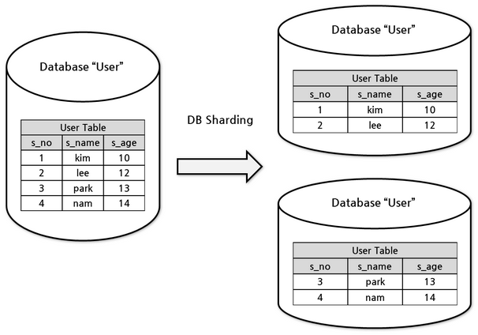
Database Sharding

Slide 45
NoSQL
NoSQL = Not only SQL.
Goal is to store data closer to the way it’s actually represented.
Several different types of NoSQL databases, each solving different scaling issues.
Growth of NoSQL correlated to the growth of distributed systems (~2010).

Slide 46
NoSQL
Four major types of NoSQL databases:
Key/value (Redis, Memcached, AWS ElastiCache)
Columnar (Hbase, AWS Redshift)
Document (Mongo, AWS DynamoDB)
Graph (Neo4j, AWS Neptune)

Slide 47
Distributed system coupling
You learned about the concept of coupling in the software engineering course.
In general, loose coupling is desirable.
Easier to maintain and replace components.
Fewer bugs and hidden dependencies.
More flexible.
Loose coupling is highly desirable in distributed systems as well.

Slide 48
Scaling performance
The speed of small systems cannot easily be translated to large distributed systems.
Applications running on a single server will encounter different bottlenecks as the service scales.
Doubling CPU or memory does not necessarily double performance.
The performance bottleneck (constraint) always changes!
Network and disk I/O are orders of magnitude slower than CPU and memory access.
Be very wary of these kinds of requests!
Slow request latencies are magnified at scale.

Slide 49
Homework
Assignment 1: Set up accounts
Watch Lecture 2 videos
Watch video on launching AWS EC2 instance:
https://youtu.be/aN6XXz192kQ
Watch video on connecting to instance:
Windows: https://youtu.be/o-ogpzXdXqU
Mac: https://youtu.be/ZFh-qA5DT6w
Optional:
Read Git Hands On Guide
Read Linux Hands On Guide

